Slide 1

Muvarde Technology Plan
TopSource Team
Andrea Echavarria | Andrew Jenkins | Chethan Mittapalli | Dante Paredes | Donald Gourley | Evan Lodge
Notes:
Hi, we are Team Topsource and today we are presenting our Final Project Technology plan for our client, Murvarde.
For a better consistent and clear flow of the presentation we will be using only one voice to narrate the presentation, however we want to clarify that this Final Presentation is the result of a dedicated teamwork effort and that all 6 members were involve in the development of this final product.

Slide 2

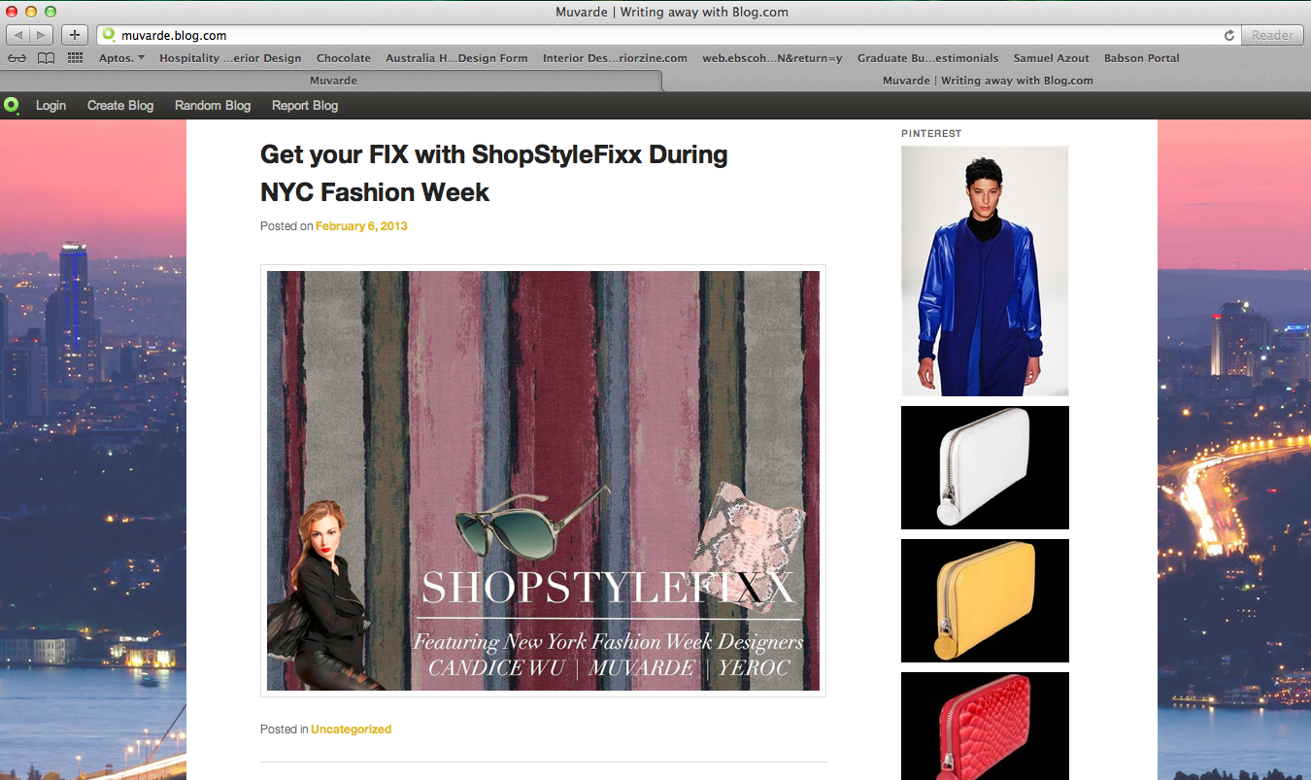
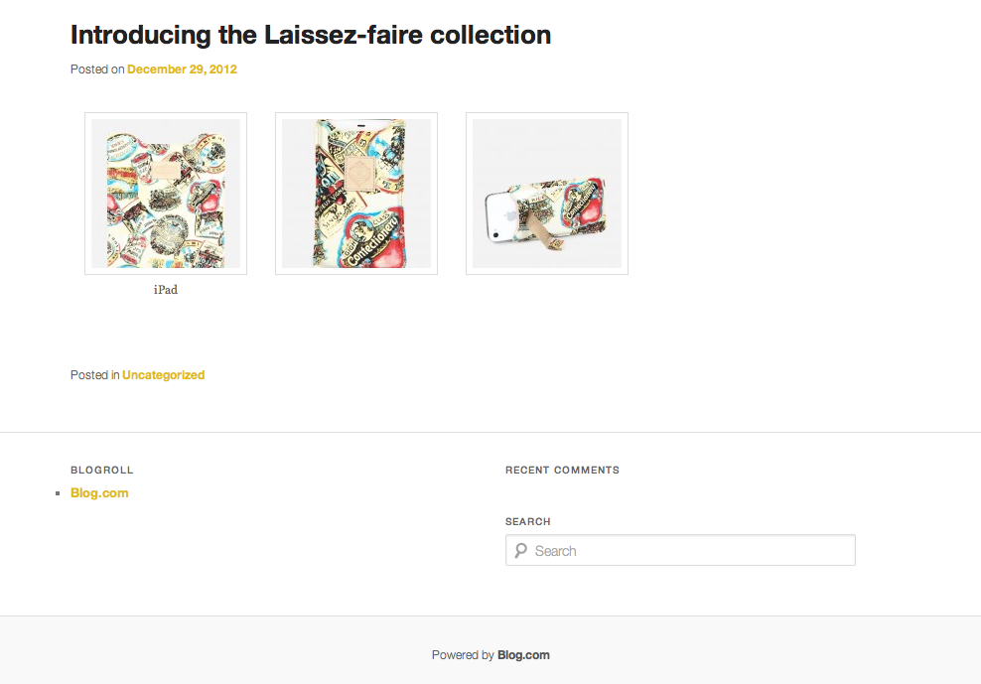
Why ?
1
No engagement on Muvarde website
2
Boost sales
Muvarde’s online communication is a monologue
3
4
Create brand awareness and an online “buzz” about Muvarde
5
One Stop engagement platform through Muvarde’s Website
6
Off-site strong and relevant presence
Last Blog made Dec 29, 2012
2
Notes:
We believe a Social Media strategy will benefit Muvarde today because:
1.First, Muvarde is not currently engaging their customers on their website. Also, today they are not implementing any Social Media tool to engage customers through website products to buy their brand.
2. Second, We want to be able to use Social Media to boost sales,Increase conversion rate and drive further sales for Muvarde
3. Third, communication is currently only from Muvarde to customers. It is not a dialogue. Right now Muvarde is pushing content is to customers but is not allowing customers to interact or to respond. Online users like to interact and have a two way conversation, they hate listening to companies only (It is important for Muvarde to understand that 14% of people trust advertising versus 84% trust other people recommendations and ratings – That is an advantage that Social Media will give to their brand)
4. Fourth, We want to be able to create brand awareness and “buzz” about Muvarde. Our Social Media recommendations enable and makes customers to talk about Muvarde. (If people talk about their brand online, it will attract new potentials customers to navigate their website and buying Muvarde products).
5. we want to create a One Stop platform for muvarde’s clients. For example, currently Muvarde is using a blog that is not very well management. The Blog is located in an outside platform (not inside our website) and this is not professional. Therefore we want to enable their website to become a One Stop or One Destination website were all the Social Media takes place (Blog,Collaboration,Community) inside their website space. This is very important because Muvarde wants to keep customers engage as long as possible and get data analysis from the information customers create on their website to keep improving their marketing, branding, selling and engagement customer experience.
6. Lastly, we want to make sure Muvarde has a strong and relevant presence in off-site platforms such as Facebook, Twitter, Pinterest and YouTube

Slide 3
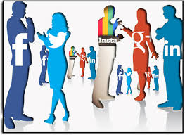


Objectives
Enhance customer engagement to complement Muvarde operations:
Offsite
Onsite
Use engagement to:
Improve Brand awareness
Influence future purchases
Refer new customers
Data analytics
1
2
Notes:
Our Social Media plan aims to engage all the previously mentioned audiences and allow them to interact with the brand in the most beneficial way possible to both Muvarde and the Customer.
To do this we will be looking at strategies for Offsite and Onsite that will aim to improve brand awareness, positively influence future purchases, attract new customers, and generate data for customer analytics. We wanted to get Muvarde customers to interact with the brand in the most beneficial way by following the best practices across all the platforms.
So, we believe engaging the customers correctly would be most important factor in retaining customers and in return this will improve customer conversion rate as well. So, for the purposes of this presentation, we will focus on solutions for the onsite and off-site experience and use the engagement to:
Identify and create Brand Advocates
Learn what customers are looking for
Keep customers aware of the brand to influence future purchases
Get customers to bring in new customers

Slide 4
Social Media On-Site Recommendations
4. Gamification
2. Customer Interaction
Spaces
3. One Platform
Muvarde On-Site Community
1. Identity Management
Badges and Super users
Commenting
Sharing
Ratings and Reviews
Notes:
Our recommendations for the On-Site Social Media will focus on Identity Management, Interaction Spaces, the creation of a One Stop Platform website, and Gamification.
1. Identity Management Allowing customers to register with the Social Media logins allows Muvarde to better understand their because they will be able to access their social media data and see all their site interaction.
2. Customer Interaction means that Muvarde allows customers to do ratings of products, reviews and have a strong comments system
3. One Platform allows Muvarde to contain all their social media and all the blogs etc. at a single place in Muvarde and not be hosted at different places so as to improve the SEO and customer engagement
4. Gamification allows the users to be engaged by providing various virtual rewards and providing offers to customers so that they help each other in the community.
In order to accomplish these goals we will also recommend that Muvarde implement several brand image recommendations and website technologies that will enable customer interaction and retention.

Slide 5
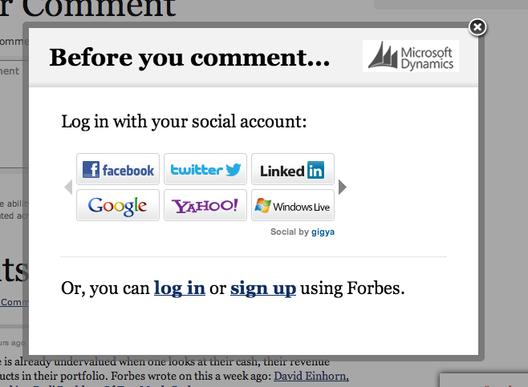
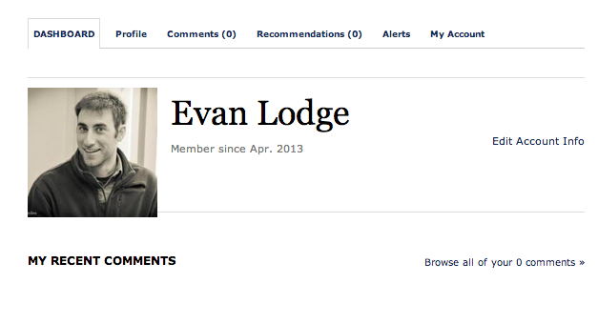
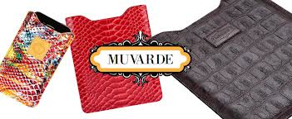
1. Identity Management
Benefits: Social Media Log In
Less Friction
Promotes user interaction
Data Analysis
"Users who login with Social Login are five times more likely to make a purchase than users who log-in via standard login"
Notes:
At its core, identity management technologies allow customers to login to our site with social media logins - meaning that someone who comes to the site is able to login with facebook for example.
Allowing customers to register with the Social Media logins allows Muvarde to better understand their behaviors because they will be able to access their social media data and see all their site interaction.This is good for the user because it removes friction from the customer interaction. This is great for muvarde because they are able to collect a substantial amount of information about their customers from their social profiles.
It has also been observed that there is a positive correlation between social login and customer purchases. In fact, using the technology we will recommend, for a specific site, users were 5 times more likely to purchase products when they were allowed to use social logins.
Source: blog.gigya.com/

Slide 6
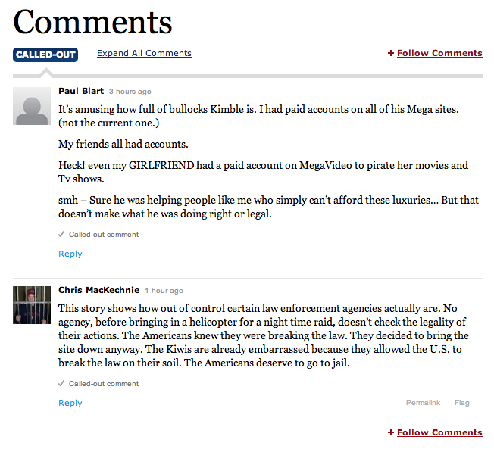
2. Customer Interaction Spaces
Commenting Benefits
Allows users to interact with each other
"The simplicity and social functionality of the Comments plugin caused a 500% jump in posted comments"
Commenting
Interaction
Blogging
Live Chat
Notes:
We want Muvarde customers to be able to interact across the site. This includes allowing customers to create comments on blog posts and other relevant areas of the website. Using comments, customers are able to interact with both each other and with Muvarde representatives. We recommend that Muvarde take advantage of this feature and create a true dialogue with their customers.
Using the specific technology package in our final presentation we will recommend later, there are examples that show a 500% increase in commenting over other systems.
Source: http://profilelaunchpad.com/blog/how-to-increase-your-linkedin-profile-views-by-500
We believe that the complete package of interaction that involves commenting, blogging and live chat with the customer service are the way forward for Muvarde.

Slide 7
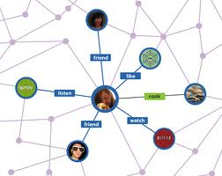
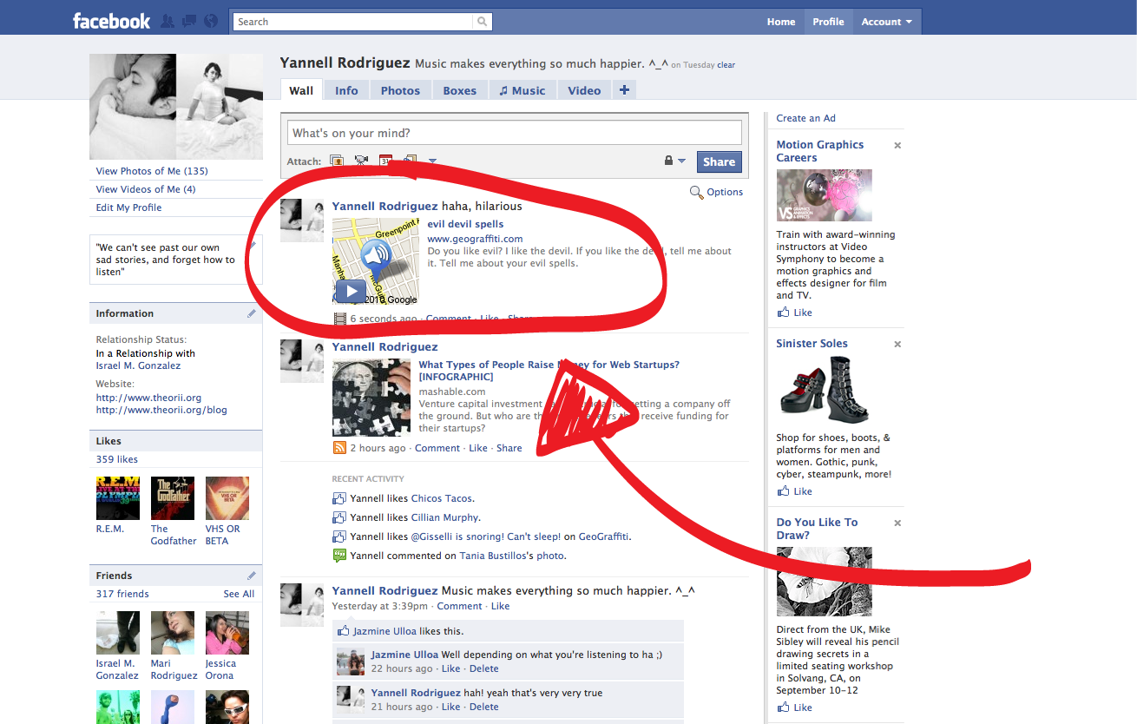
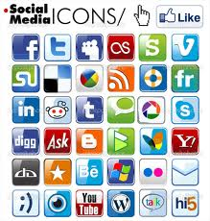
2. Customer Interaction Spaces
Sharing Benefits
Brand awareness
New visibility
Sharing
Notes:
Muvarde should also implement social share buttons across the site. Each product should be shareable and users should be able to share what they just purchased with their network.
The goal is to utilize our customers social graph to bring new business and generate awareness of the brand. As we have seen with Linked map it is very important to understand powerful influencers or super users and any shares or tweets by them could generate additional traffic to the site and increase the sales.
For example: We want Muvarde Customers to be able to share Muvarde’s latest news in regards to products, purchases, leather trends.

Slide 8
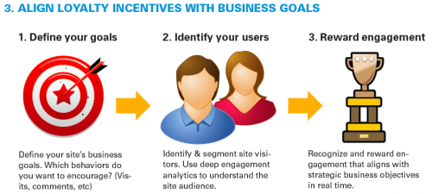
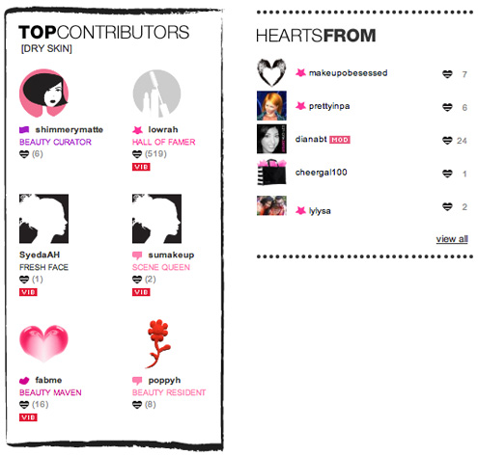
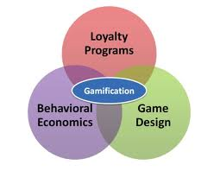
3. Gamification
Ratings and Reviews Benefits
Increases Social Activity
Determines influencers
Influencers will bring new customers
Fosters constant interaction with Muvarde
Notes:
Gamification is very important. It can be applied to all of the other features we have talked about.
“Gamification techniques leverage people's natural desires for competition, achievement, status, self-expression, altruism, and closure”
Source: Wikipedia.
With gamification we will reward users with virtual awards and incentives for the acts of interacting with our site, sharing, and generally being a influencers. traditionally With gamification, Users participation Status gets linked to their profile and is marked by custom badges.
There are numerous examples of how gamification has increased traffic and participation to unbelievable levels.
Other than entertaining users, the goal is to generate data for Muvardes to figure out who their most active and influential users are, and what they are saying on the site.
This allows Muvarde to better target their promotional strategy towards these users. Also, we think that using Gamification to provide offers to super users and have various options in mind like assigning the users silver badge, gold badge, platinum badge based on their activity in the community creating positive competition and encouraging engagement in the website.
We recommend for Muvarde to create a game for engaged customers to compete for the ultimate leather outfit. So they can make a table of rewards for those customers who accomplish tasks visible to other players. For example for every 20 blog comments users can obtain a leather belt, for posting 4 Youtube videos using Muvarde’s products they can get a customized leather hat figure. And when a user's reputation points exceed various thresholds, they can gains additional privileges, including discounts for products, the privilege of helping to Muvarde moderate the blog for a month.
Note: DevHub, announced that they have increased the number of users who completed their online tasks from 10% to 80% after adding gamification elements

Slide 9



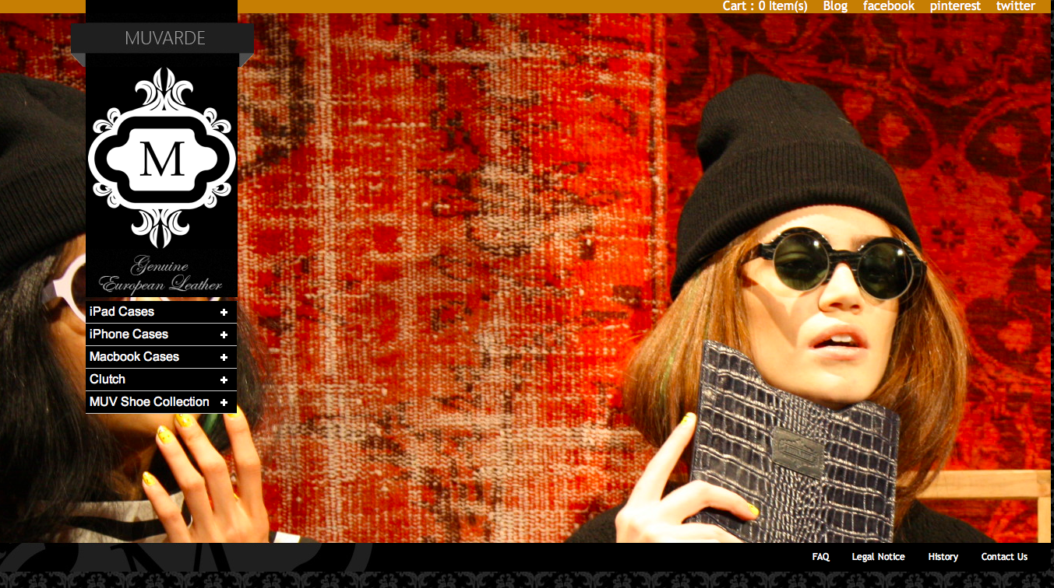
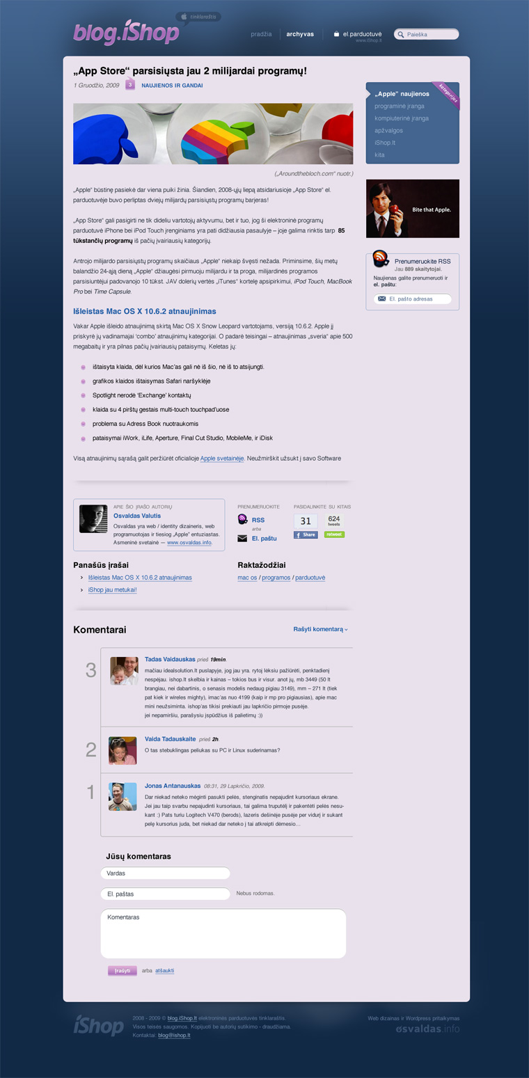
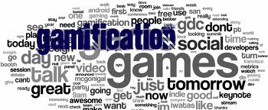
4. One Platform
Benefits
Brings user to Muvarde website
Ensures that current customers can see new products
Notes:
Our fourth recommendation for Muvarde is to turn their website into a One Stop platform. We want to encourage their customers to remain on their site for as long as possible.
For example, currently Muvarde is not making effective use of blogging technology. They have an off site blog that hardly gets updated. We want them to move that blog onto the Muvarde.com domain and implement commenting features on it.
Moving the blog onto the site will have an additional benefit of increased search engine optimization. Most of the crawlers try to put the websites with blogs attached to the website in the top of the search results and given more priority.

Slide 10
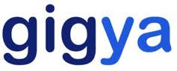
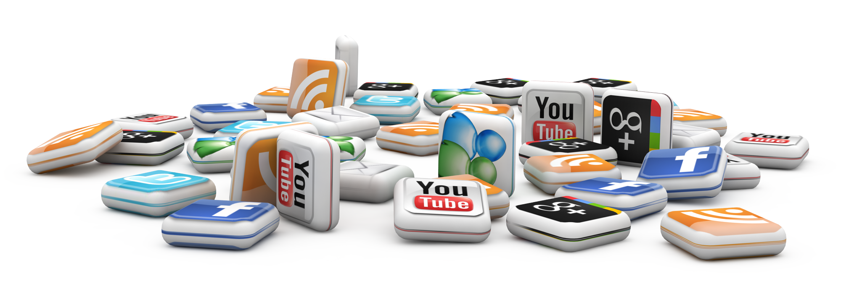
Recommended Technology
Notes:
In order for Muvarde to enable their website as a One-Stop platform and after going through many of the technology options for each of the described features, we have come to the conclusion that the best solution is to implement Gigya.
After analyzing the best of breed of all of the different categories of social networking there are some solutions that work better than others, or have more market support credibility, but none of the companies does all the things that we want to implement, including - Commenting, Ratings and Reviews, Gamification, and Social Profile Management.
Please take a look at the exhibits to undestand how Gigya compares with other social media platforms.
It is also important for Muvarde to connect our recommended Social Media strategy to all the available platforms such as Facebook, YouTube, Twitter etc. in order to ensure their relevance in all those spaces, but always trying to bring the customers to their One Stop website.

Slide 11
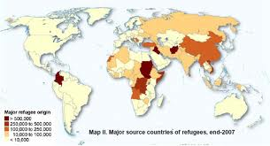


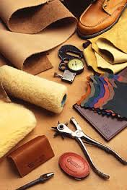

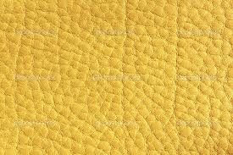
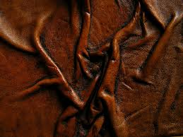
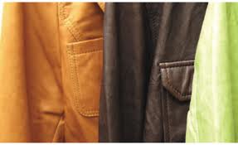
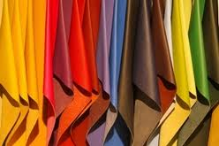
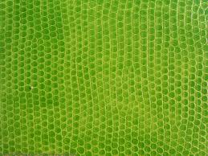
Website Recommendations
Notes:
In order to create a an engage community it is important for Muvarde to have content in their One-Stop Platform that is easy and interesting to follow, that is why Muvarde needs to make introduce smart ways that allow them to engage customers thought their 5 senses.
In order for Muvarde to get movement, they need to generate the right content to attract the first followers that are usually Super Users, New Joiners or Loyal Costumers to their One-Stop Platform. So to nurture those important first followers successfully we recommend Muvarde not to only create relevant technology spaces but to feeding them with vibrant images and relevant and unique content that will induce customers desire to spend more time navigating and interacting with Muvarde constantly.
That is why we are recommending for Muvarde to become a leather expert platform. They can do this by feeding its website with constant relevant information about leather’s place origin. (Put a map were Customers can identify the country of origin, best quality, textures, talk about the new trendy dying colors, talk about innovative cleaning products for and and for example create a leather glossary with history of origin. It is important for Muvarde to allow customers to interact with a Lather Expert with a live chat for questions and answers. Becoming an expert will ensure increase traffic and user engagement.
In order to implement this idea, Muvarde will require a Social Media manager or an intern that can constantly interact with customers. Besides, they will have to get sources of information from a research firm and this might require subscription and some financial resources.

Slide 12
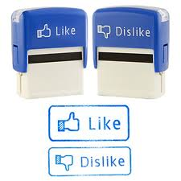
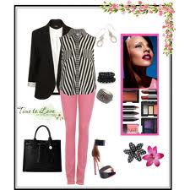
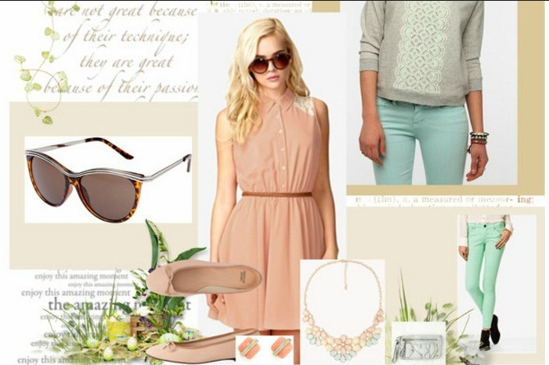
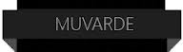
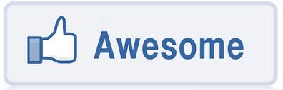
Muvarde Fashion Combinations
Is more than just Like or Dislike Muvarde’s look should be about awesomeness!
Notes:
Another recommendation we have for Muvarde to ensure the engagement of customers with their Social Media efforts is to create amazing pictures. So in order to engage fashionable conscious consumers we are recommending Muvarde to portray their products with theme-based image or collections styles so customers can experience a unique bundle of fashionable associations.
Consumers want image, and lots of them so Muvarde needs to make sure their pictures are always being updated and are always visual storytelling.
On Facebook up to 250 million photographs are uploaded every day, and those photographs are prominently featured on the social media platform.
A post that includes an album or picture receives 120-180% more engagement from fans than a text-based post.
Source: http://www.socialmediaexaminer.com/storytelling-with-images/
For example if Muvarde combine its products with other fashionable items, customers will be able to imagine a Muvarde perfect outfit. Also,Portraying Muvarde products as Fashionable Combinations can be the difference between just a LIKE and a loyal awesome customer.
In order for Muvarde to implement this recommendation they will need to have a Social Media manager who can constantly update the images to their platform and into all social media. In addition, they need to probably outsource fashion photo-shoots.

Slide 13
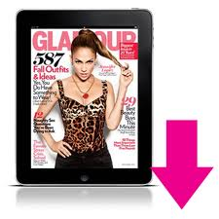
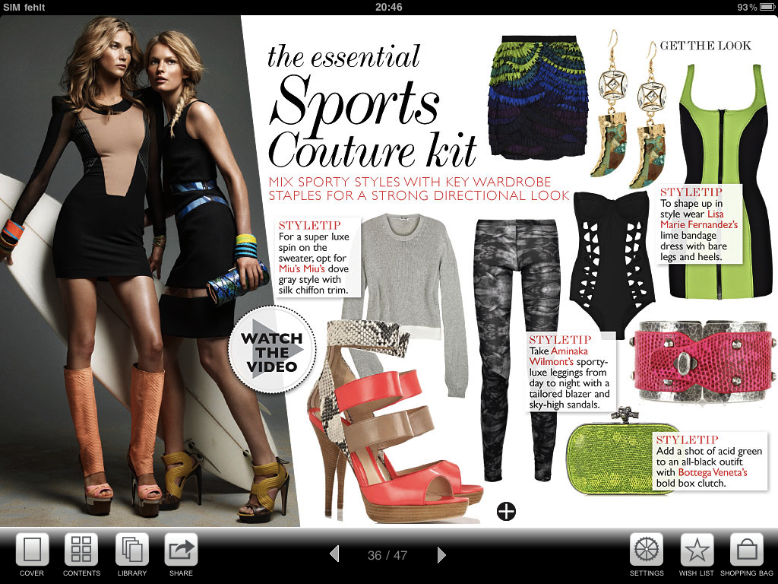
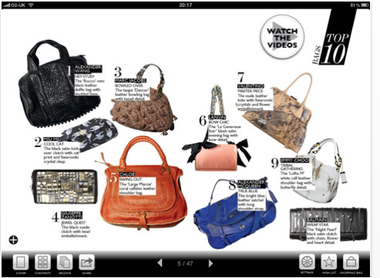
Fashionably Relevant
People see Muvarde as a Fashionable item that they MUST HAVE!
Muvarde
Notes:
Muvarde should also put some effort in showcasing their products in other fashion websites. This will enable them to redirect early fashion adopters and new spectators to their website. This will require Muvarde to have some type of Public Relations management in order to ensure their products are available and considered for fashion collections.

Slide 14

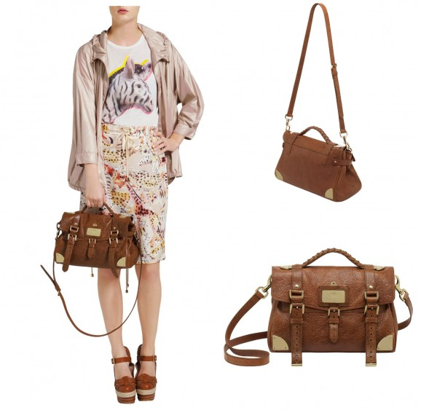
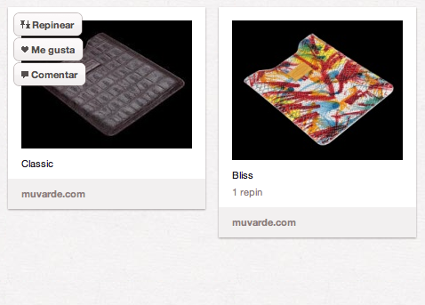
Product Web Image
Customers like to see the relevant size of the product.
Show the product being use in several ways
Notes:
We also recommend Muvarde to showcase their products relevant to daily life activities. Customers are more likely to purchase an item online if they can understand the dimensions, functionality and versatility.

Slide 15



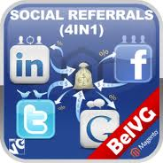
Shopping Cart
Add advanced shopping cart
Social media integration
Share and tweet my cart products
Reviews, Ratings
Refer a friend – products
Discounts for social media referrals
Bundle similar recommendation products
Notes:
Muvarde should add an advance shopping cart to enable social media integration. It is important for Muvarde to allow customers to share their purchases from their shopping cart, make reviews and ratings.
In addition, Muvarde can create a discount code for customers who by referral can engage their friends to buy at Muvarde. At the same time, it is important for Muvarde to showcase or recommend complementary products to customers when they are in the checkout process. As we see in Amazon who generates additional revenues by bundling the products and offering discounts so that users can end up buying more stuff.

Slide 16
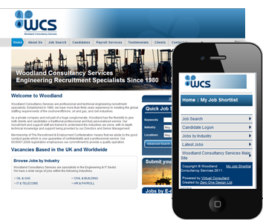
Mobile compatible website
Responsive design principles
Compatible with all mobile platforms
Benefits
Improved user experience
longer visits
Improved SEO
Better Brand image
Competitive advantage
Notes:
Using responsive design principles Muvarde should design a website that is compatible with all mobile platforms. If we look at http://www.engadget.com which has a mobile compatible website the layout of the website and resizing of layout etc happens automatically without effecting the user experience.
Benefits:
•Improved user experience
•longer visits
•Improved SEO
•Better Brand image
•Competitive advantage

Slide 17
Recommendation Prioritization Scores
Notes:
We believe that Based on business value and likelihood of success, adopting and identity management system is the most important large feature suggested followed by custom interaction spaces, one-stop platform, gaming and an interacting shopping cart.

Slide 18
Social Media Metrics
Awareness | Engagement | Word of Mouth
# of members/fans # of impressions # ratings/reviews # of tweets # of followers # of page views # of visits # of users # of views # of connections | # of comments # of active users # of user-generated items Rate of activity Time on site (Likes + Comments + Shares)/Total Fans Conversion rate, Engagement rate, Bounce rate Company comments/Total comments Network density # of responses to polls, contests, surveys, etc. # of @replies Sentiment Analysis (Positive, Negative, Neutral) | # times appearing in friend’s timeline # posts on wall # reposts # of responses to friend referral invitations # of likes on friends’ feeds Influence, reach scores # of re-tweets # of shares Measure Share of Voice(SOV) Brand mentions on social media
Notes:
Awareness,Engagement and word of mouth metrics are important metrics to analyze the success of our new social media strategy. So, awareness metrics such as number of fans,tweets,connections,pageviews,visits can be used to evaluate the reach of our brand among our users.
Engagement metrics such as active users,comments,conversion rate,engagement rate,bounce rate and sentiment analysis shows the interest of users in our site and how much engaged they are in our content and collaboration platform. Its important to retain our customers for the maximum time on our site to generate more sales.
Word of mouth marketing by existing customers acts as a key influencer for new customers and metrics such as number of posts on facebook,retweets,influence scores,share of voice index and brand mentions on social media shows that our customers are very loyal to our brand and would go that extra mile to promote our brand.

Slide 19
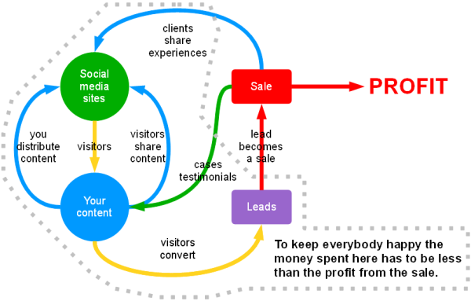
Social Media ROI Metrics
Financial Returns
Socially Referred Revenues
Media Equivalent Value
New Customers
Non Financial Returns
Brand Value
Customer Engagement
Market share increase
New Leads, Referrals and Impressions
Customer Satisfaction
Notes:
It is important for Muvarde to measure the ROI of all its social media and technology investments.
Social media activities and technology investments influence the common ROI financial metrics which are: Number of transactions, Number of customers, Number of new customers, Market share, Revenue and Profit.
That is why is important to have a clear understanding that about how to connect the financial returns to the social media returns that are: Number of website visitors, leads, Brand awareness, Newsletter sign-ups, Facebook fans, Blog comments, Brand Social mentions and Visitor satisfaction.
It is important for Muvarde to connect their financial measurements to their Social Media strategy and for example by monitoring the social chatter they can measure the relation between the number of mentions of their brand on the internet to changes in sales volume.
Source: www.oracle.com/us/c.../social-media-the-tipping-point-1908447.pdf

Slide 20
Social Media Metrics Tools
Engagement and Reach
Facebook Insights
Share of Voice(SOV)
Social mention
Influence
Klout
Radian6
PeerIndex
Linkedin page insights
Pinterest web Analytics
Kred
Referral Traffic
Google Analytics
Social Reports
Notes:
Muvarde can use some of the existing social media metric tools that helps evaluate the existing awareness,engagement and word of mouth key metrics to get a realistic view and take action to improve them. We recommend using tools such as facebook insights,linkedin page insights and data analytics to measure engagement and reach of its customers.Share of voice is another relevant metric and social mention is a good tool for measuring it and klout can help in tracking your top influencers.
Finally,Google analytics and especially its social reports can help in measuring network referrals,conversions,trackbacks,visitor flows and track activity of visitors across various sites which would help build a strong recommendation system in future by analyzing user patterns across the internet sites.

Slide 21
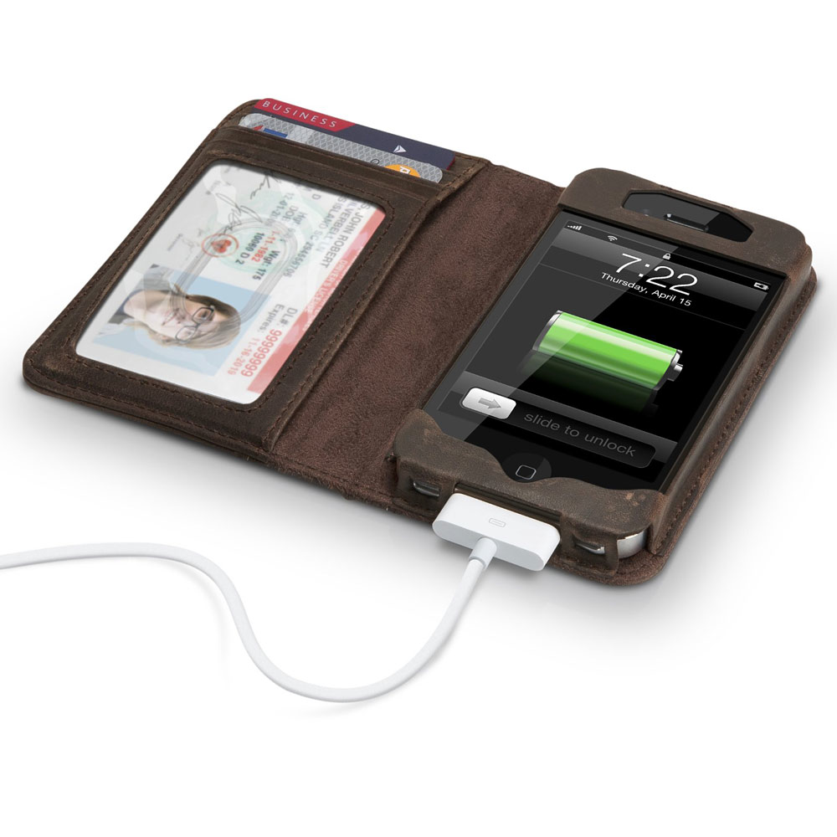
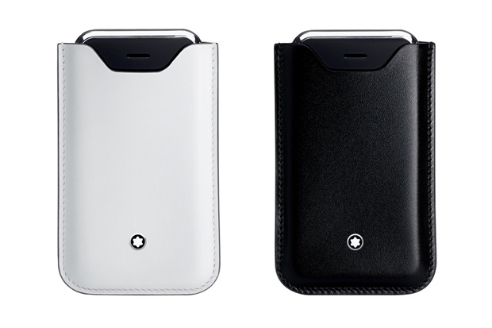

Thank you Muvarde Always Relevant

